Slide 1
Class Topics:
Basic Networking
Basic Operating System
How a mobile device works
এগুলো জেনে কী হবে? কেনো শিখছি?

Slide 2
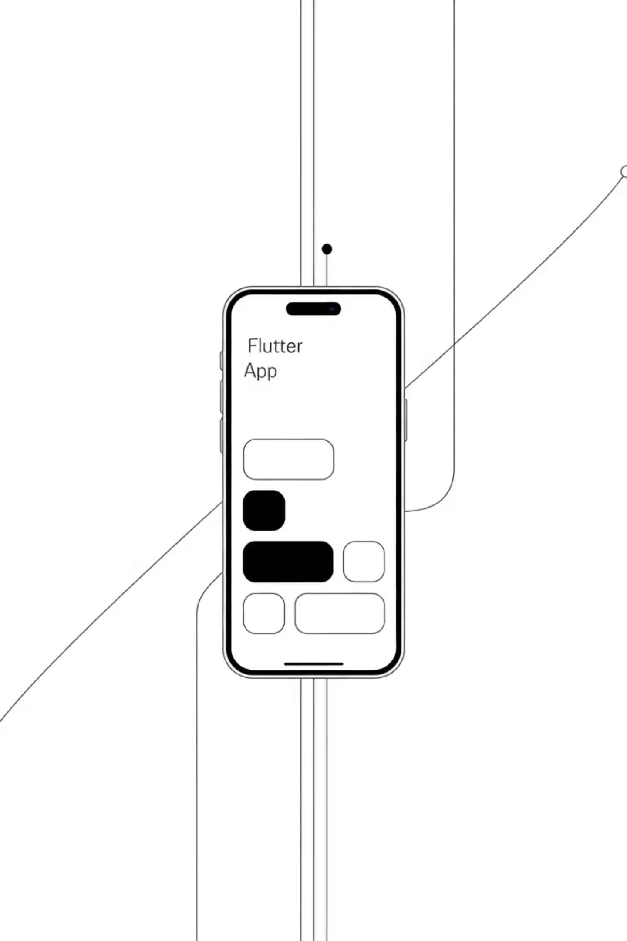
Why Networking, OS & Mobiles?
Understanding the foundation that powers your Flutter applications

Slide 3
Why Networking, OS & Mobiles?
You want to build Flutter apps → Where will they run? On mobiles!
Who controls mobiles? Operating Systems!
How do apps talk to each other? Networking!
Story: "When I made my first Flutter chat app, it worked perfectly… on my phone only. Didn't send messages to others. Why? I didn't understand networking basics."

Slide 4
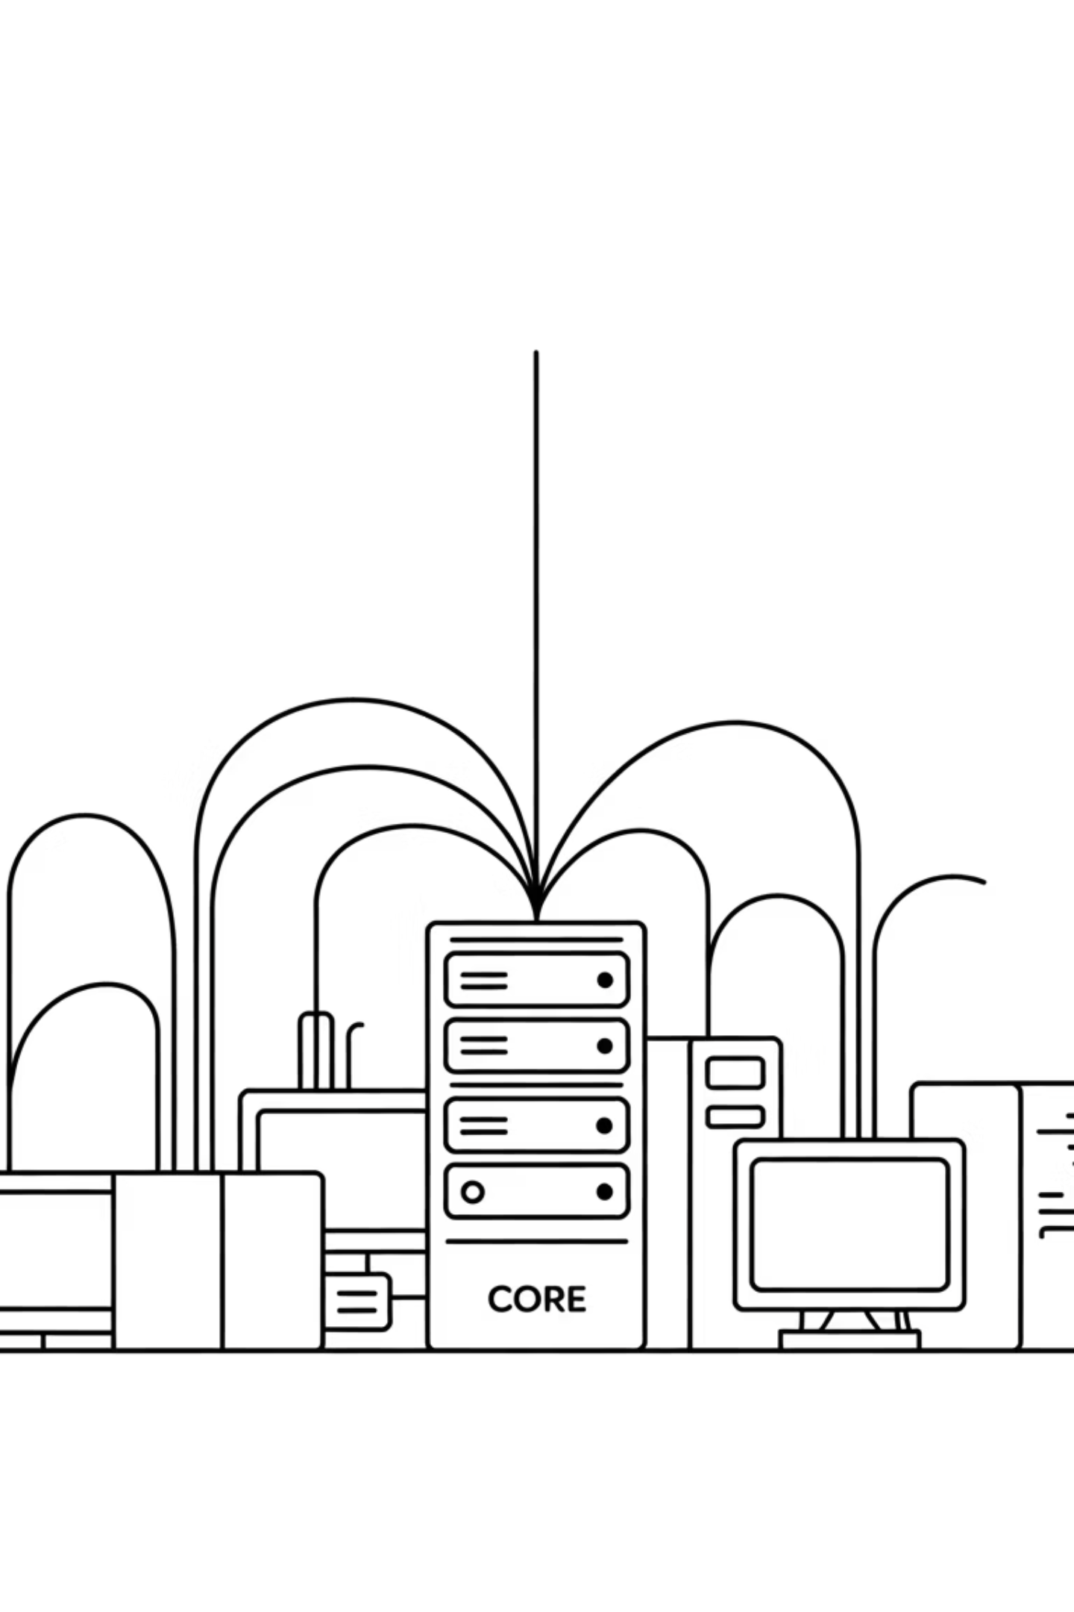




What is Networking (Simple)
Networking = devices talking to each other
Like humans need language, computers need protocols
Example: WhatsApp → You send text, it travels through network → Shows up on friend's phone
Interactive: Ask: "When you press LIKE on Facebook, where does that info go first?"

Slide 5
Networking Basics for Flutter Devs
IP Address
Protocols
API
IP address = unique identity (like your house number)
Protocols (HTTP, HTTPS) = rules of talking
API = the waiter who brings food from kitchen to your table
Flutter Relevance: When you call an API in Flutter (http.get), you're literally doing networking.

Slide 6




Real Example – Flutter & Networking
Login Screen
Server Processing
Without Networking
Flutter sends data to server
Server checks, replies with success/failure
app = offline calculator
Story: "I once built a weather app in Flutter. It showed only Dhaka weather. Why? I hardcoded it. Didn't fetch data from network API. Students laughed at me."

Slide 7

What is an Operating System (OS)?
OS = the manager of your device
Controls hardware, apps, memory
Examples: Android, iOS, Windows
Interactive: Ask: "What's running your Flutter emulator – hardware or OS?"

Slide 8
OS for Flutter Developers
How Flutter Apps Work
Platform Differences
Flutter apps don't run directly on hardware
iOS has strict rules (App Store)
They talk with OS → OS controls device
Android = more flexible (Google Play)
Flutter Relevance: You must test your Flutter app on both OS because same code may behave differently.

Slide 9
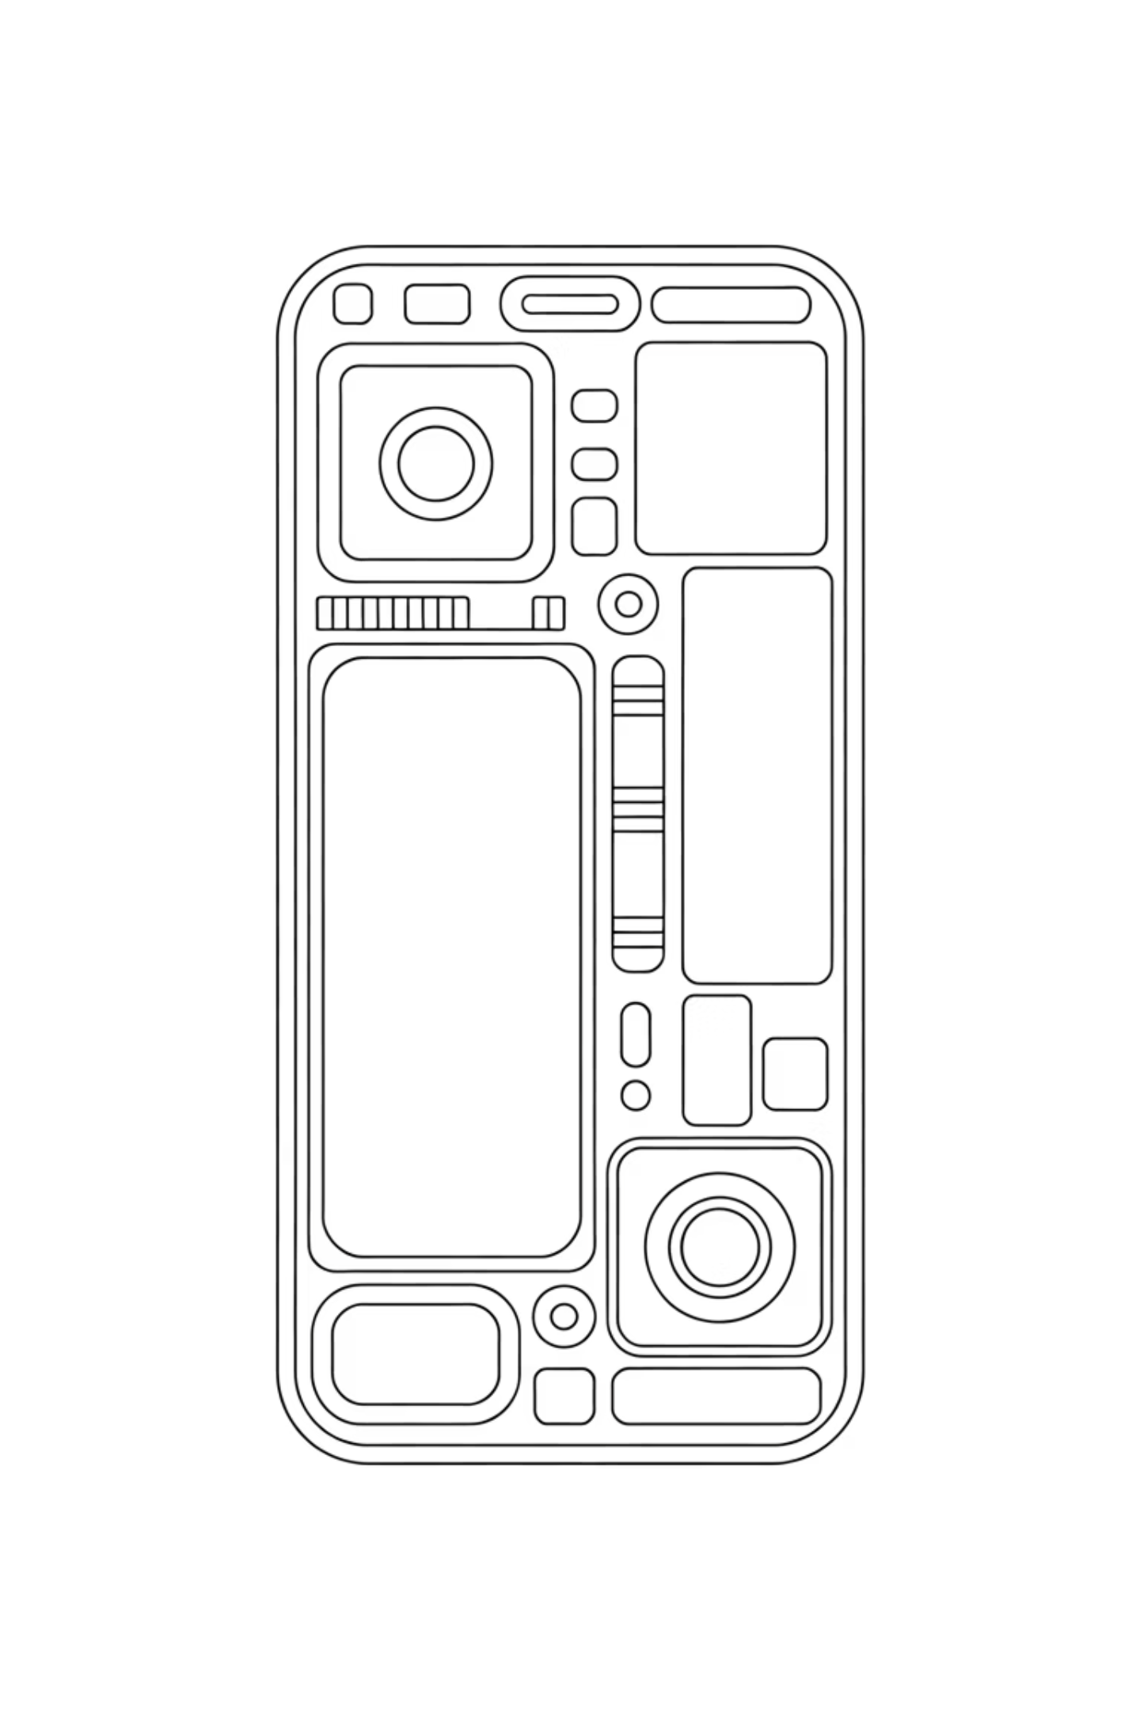



Mobile Device – The Playground for Flutter
Mobile = a small computer in your pocket
Has CPU, RAM, ROM, Battery, Sensors
Works with OS + Network to run apps
Example: Camera app → needs camera hardware + OS permission. Flutter app → same.

Slide 10








How a Mobile Device Works
Input
Processing
Touch, mic, sensors
CPU + GPU
Output
Memory
Screen, speaker, vibration
RAM for running, ROM for storing
Interactive: Ask: "When you swipe Instagram feed, which part of mobile is working hardest?" (GPU + Network).

Slide 11
Mobile & Flutter Connection
Cross-Platform Power
Story: "I built an animation-heavy Flutter app. Worked great on my phone. Crashed on my friend's 3GB RAM phone. Lesson: test on low-end mobiles too!"
Flutter is cross-platform: One code → Multiple devices.
But devices have different RAM, OS, battery limits.
That's why developers need to optimize apps.

